Slide 1
HALLUCINATION DETECTION IN LLMs
by:
Karthikeyan S
Krithika C
Lavanya Vasudevan
UCS2604 – PRINCIPLES OF MACHINE LEARNING
UCS2612 – MACHINE LEARNING LAB

Slide 2
ASSIGNMENT - 1

Slide 3
PROBLEM STATEMENT
The problem is to detect hallucinations in Large Language Models (LLMs) using supervised learning, ensuring accurate and trustworthy AI-generated content, particularly in critical domains such as healthcare, law, finance, and education.

Slide 4
Hallucination detection in llmS
Hallucination in LLMs
LLMs generate fabricated or factually incorrect outputs.
Errors arise due to missing training data or faulty reasoning in retrieved knowledge.
High impact in critical domains like healthcare, law, and finance.
Retrieval-Augmented Generation (RAGs)
Enhances factual accuracy by retrieving external knowledge.
Still prone to hallucinations if retrieval is incomplete or reasoning is flawed.

Slide 5
DATASET

Slide 6
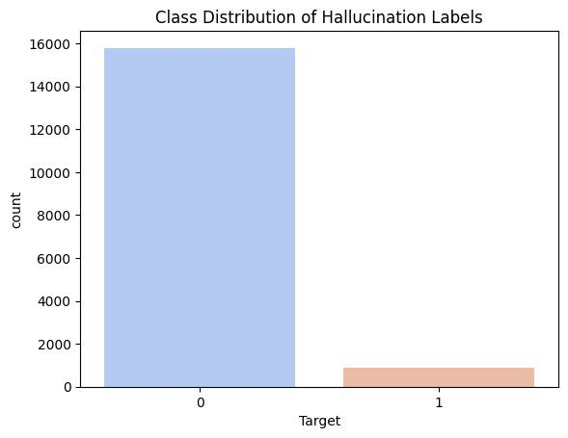
DATASET DESCRIPTION
The dataset contains 16,687 entries with four columns: Id, Prompt, Answer, and Target.
It has a class imbalance, with ~15,000 "No" (factual) and ~1,000 "Yes" (hallucinated) labels.
SMOTE is applied to oversample the minority class for balanced training.
BERT embeddings require ADASYN, as SMOTE struggles with high-density data.
A bar plot visualizes the improved balance after resampling.

Slide 7
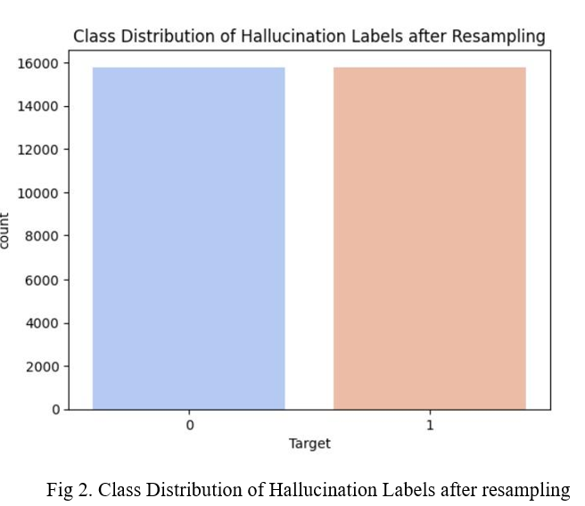
Class distribution after resampling

Slide 8
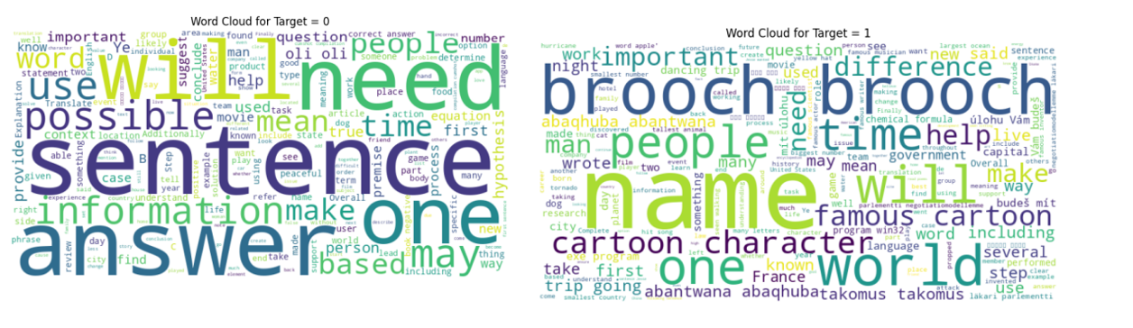
WORD CLOUDS

Slide 9
PROPOSED SOLUTION

Slide 10
PROPOSED SYSTEM
1. Loading the Dataset
Load the hallucination dataset with columns: Id, Prompt, Answer, Target.
2. Exploratory Data Analysis (EDA)
Generate descriptive statistics to identify trends and anomalies.
Create word clouds for hallucinated ("No") and factual ("Yes") responses.
Analyze text length differences between the two classes.
Identify class imbalance with "No" responses dominating.

Slide 11
Proposed system
3. Preprocessing
Remove special characters, punctuation, and numbers.
Tokenize text into words using NLTK and remove stop words
Apply lemmatization to reduce words to their base forms.
4. Vectorization
TF-IDF:
Compute term importance using TF-IDF scores and generate a sparse matrix for ML models.
BERT Embeddings:
Load pre-trained BERT tokenizer and model.
Extract embeddings from last_hidden_state.
Apply embeddings to processed text for model training.

Slide 12
PROPOSED SYSTEM
5. Machine Learning Models
Train models to classify hallucinated ("No") and factual ("Yes") responses using TF-IDF and BERT embeddings:
Logistic Regression
Random Forest
KNN
6. Evaluation Metrics
Assess model performance using:
Accuracy
Precision, Recall, and F1-Score
Confusion Matrix and ROC Curves

Slide 13
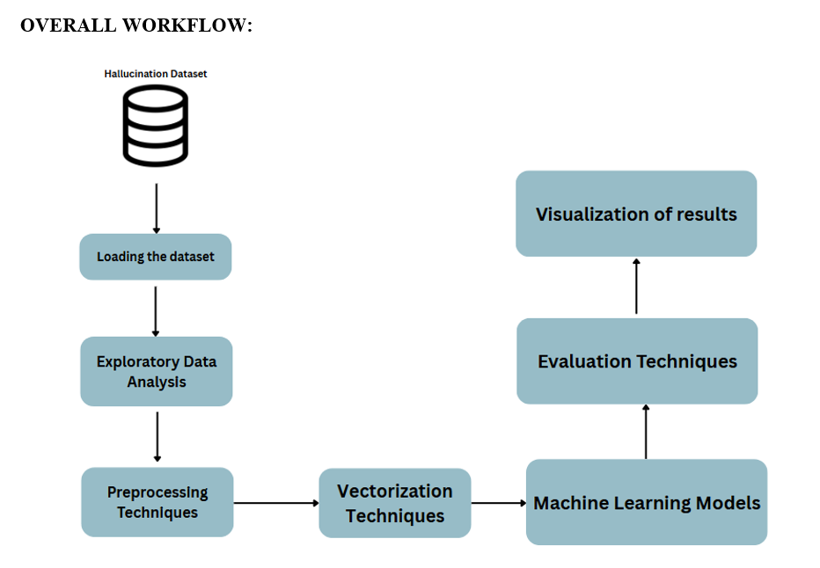
OVERALL WORKFLOW

Slide 14
PREPROCESSING TECHNIQUES
Lowercasing: Converts all text to lowercase to maintain uniformity and ensure case insensitivity during analysis.
Removing Special Characters: Eliminates punctuation, numbers, and special symbols, retaining only alphabetic letters and spaces to focus on meaningful text content.
Tokenization: Splits the text into individual words (tokens) using from NLTK, enabling easier manipulation of textual data.
Stopword Removal: Removes commonly used words (e.g., "the," "is," "and") from the text using NLTK's stopwords list to emphasize important terms.
Lemmatization: Reduces words to their base form (e.g., "running" → "run"), ensuring consistency and reducing dimensionality.
Joining Tokens: Combines the processed tokens back into a single string with spaces for further processing in the vectorization step.

Slide 15
VECTORIZATION
TF-IDF Vectorization: Converts text into a sparse numerical matrix by assigning weights
words based on their importance, making it suitable for traditional machine learning models.
BERT Embeddings: Uses a pre-trained BERT model to generate dense vector representations of text, capturing contextual meaning for advanced NLP tasks.

Slide 16
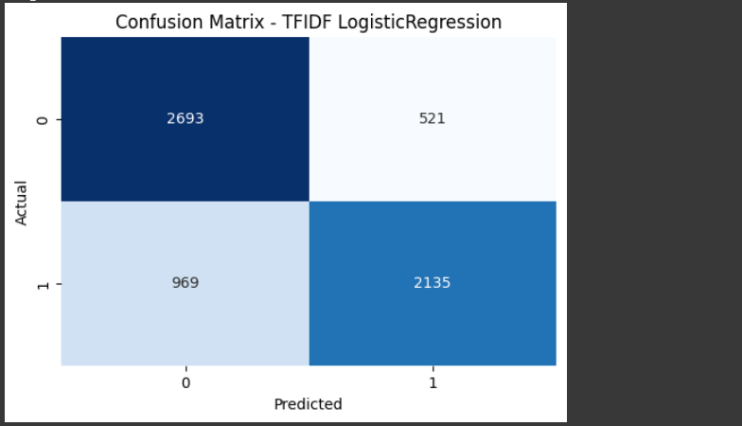
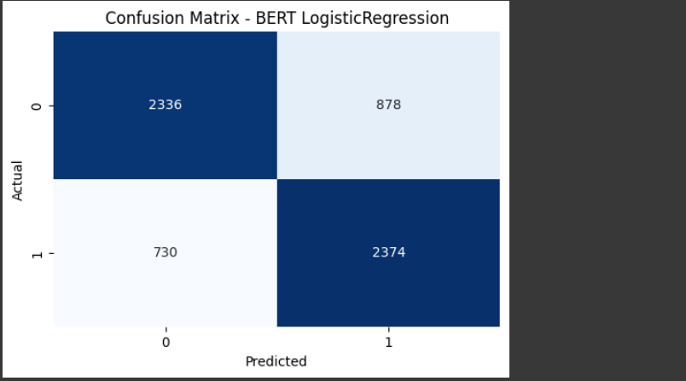
LOGISTIC REGRESSION

Slide 17
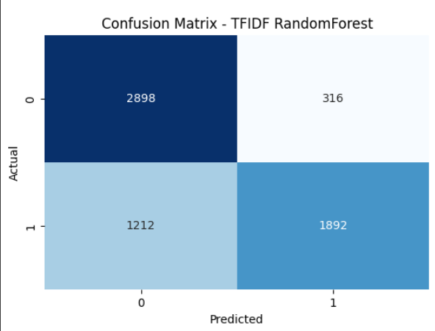
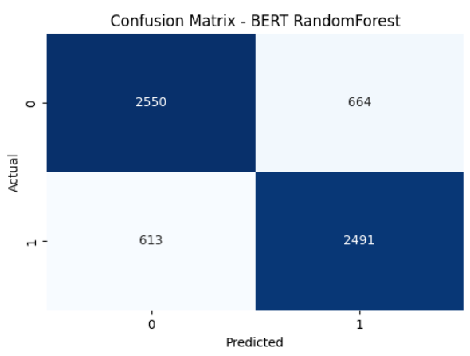
RANDOM FOREST

Slide 18
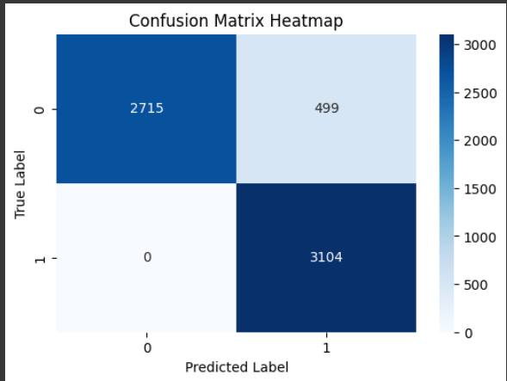
KNN

Slide 19
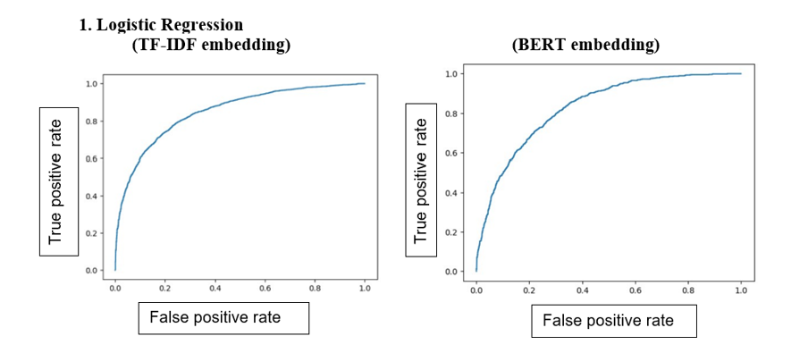
Roc curve (logistic regression)

Slide 20
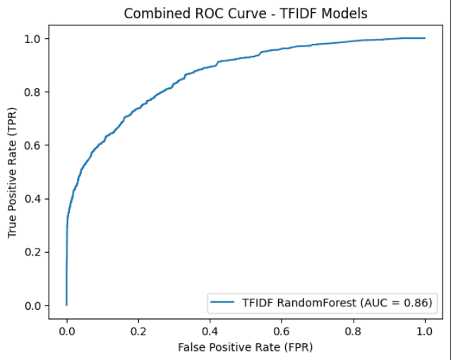
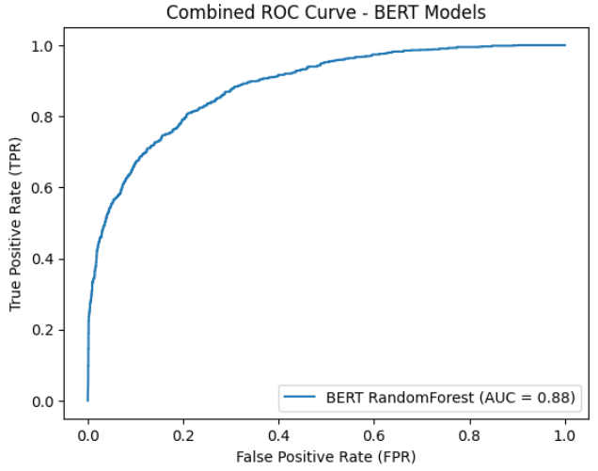
ROC CURVES (RF+TFIDF , RF+BERT)

Slide 21
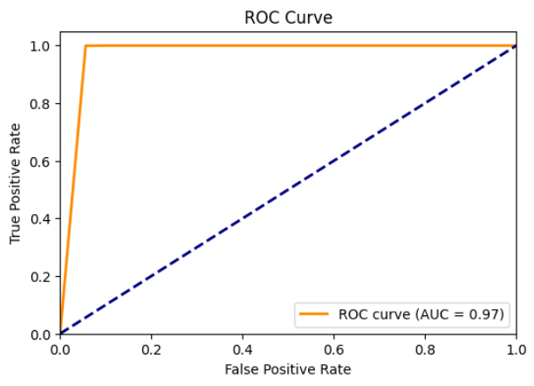
ROC CURVE (KNN)

Slide 22
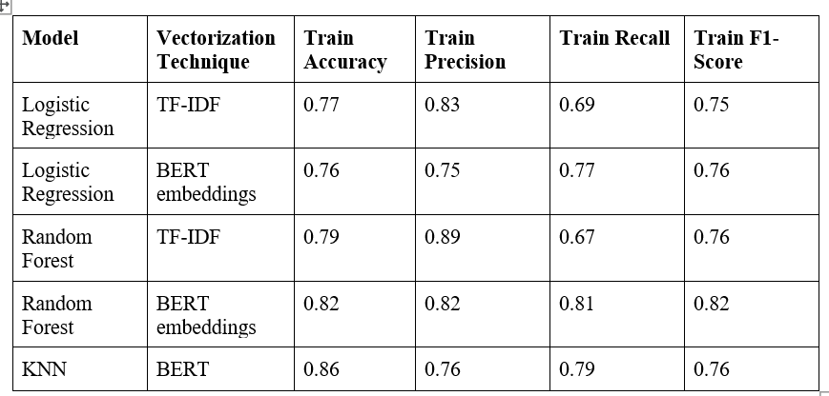
RESULTS (TRAIn)

Slide 23
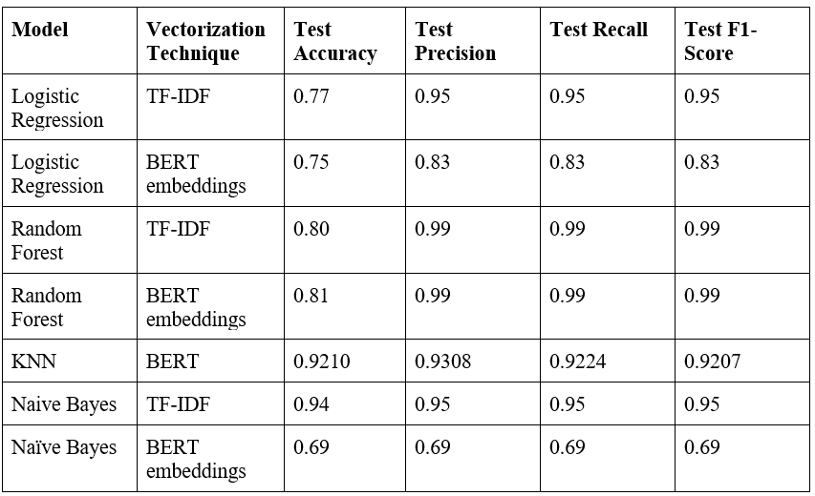
RESULTS (TEST)

Slide 24
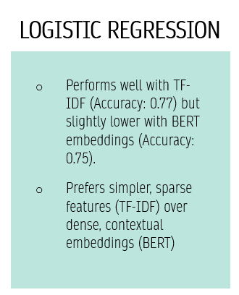
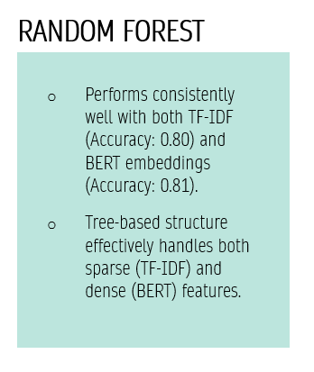
discussion

Slide 25
ASSIGNMENT-2

Slide 26
CONTENTS
Dimensionality Reduction Techniques
Hyper-parameter and model-parameter tuning
Optimized Model
Results prior to Optimization
Results post Optimization

Slide 27
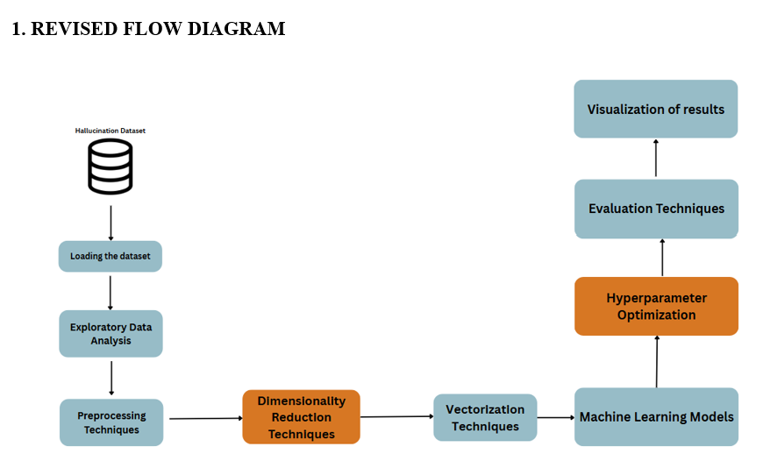
REVISED WORKFLOW

Slide 28
DIMENSIONALITY REDUCTION TECHNIQUES
For Hallucination Detection using LLMs

Slide 29
PRINCIPAL COMPONENTS ANALYSIS ( PCA )
Unsupervised dimensionality reduction technique preserving variance.
Uses eigenvalue decomposition of the covariance matrix.
Helps in feature extraction, noise reduction, and visualization.
Assumes linear relationships and is sensitive to scaling.
Improves efficiency by reducing redundancy in high-dimensional data.

Slide 30
Linear discriminant analysis ( lda )
Supervised technique maximizing class separability.
Computes scatter matrices to optimize class distinction.
Effective for classification with dimensionality reduction.
Assumes normal distribution and equal class covariances.
Used in face recognition and text classification.

Slide 31
TRUNCATED SINGULAR VALUE DECOMPOSITION ( TSVD )
Matrix factorization technique reducing data dimensionality.
Works directly on the original matrix, unlike PCA.
Useful for sparse, high-dimensional data (e.g., text processing).
Applied in Latent Semantic Analysis (LSA) for NLP.
Computationally efficient but does not preserve variance or class structure

Slide 32
SelectKBest for Feature Selection
Selects top k features based on statistical tests.
Improves model performance by removing irrelevant features.
Methods include chi-square (χ²) for classification & mutual info for regression.
Retains original features, unlike PCA or TSVD.
Proper k selection is crucial to avoid underfitting or complexity.

Slide 33
Hyper parameter tuning
For Hallucination Detection using LLMs

Slide 34
Logistic Regression Hyperparameters
Parameters: Coefficients (weights) & intercept.
Hyperparameters:
max_iter=50: Maximum optimization iterations.
penalty='l2': L2 regularization to prevent overfitting.
C=0.01: Controls regularization strength.
solver='liblinear': Preferred for small datasets.

Slide 35
Random Forest Hyperparameters
Parameters: Tree splits & feature importance learned during training.
Hyperparameters:
n_estimators=20: Number of trees in the forest.
max_depth=5: Limits tree depth to prevent overfitting.
max_features='sqrt': Selects subset of features per split for efficiency.

Slide 36
K-Nearest Neighbors (KNN) Hyperparameters
Non-parametric model relying on stored training examples.
Hyperparameters:
n_neighbors=5: Number of nearest neighbors considered.
weights: 'uniform' (equal influence) or 'distance' (closer neighbors matter more).
metric: Distance calculation method ('euclidean', 'manhattan').

Slide 37
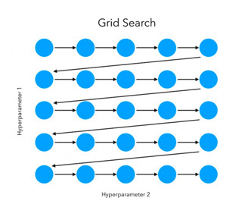
GRID SEARCH
Exhaustive search over a predefined set of hyperparameters.
Evaluates all possible combinations to find the optimal set.
Guarantees the best tuning but is computationally expensive.
Works best for small hyperparameter spaces.

Slide 38
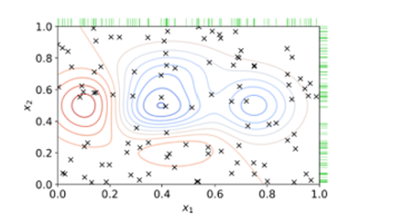
RANDOM SEARCH
Randomly selects hyperparameters from a given range.
More efficient than Grid Search for large search spaces.
Finds near-optimal values faster in high-dimensional spaces.
Preferred when computational resources are limited.

Slide 39
OPTIMIZED MODEL
For Hallucination Detection using LLMs

Slide 40
UPDATED WORKFLOW

Slide 41
Comparative Analysis of Models across Dimensionality Reduction

Slide 42
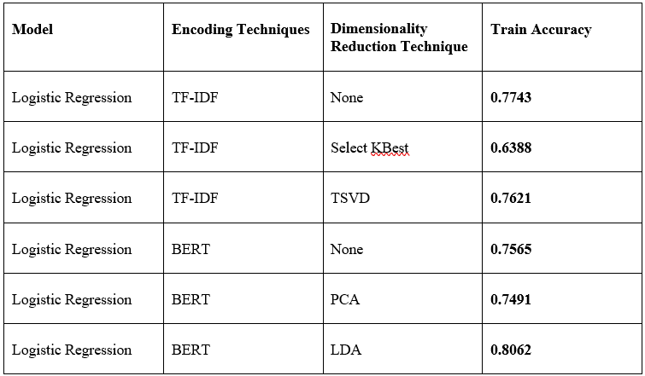
Logistic regression(Train accuracy)

Slide 43
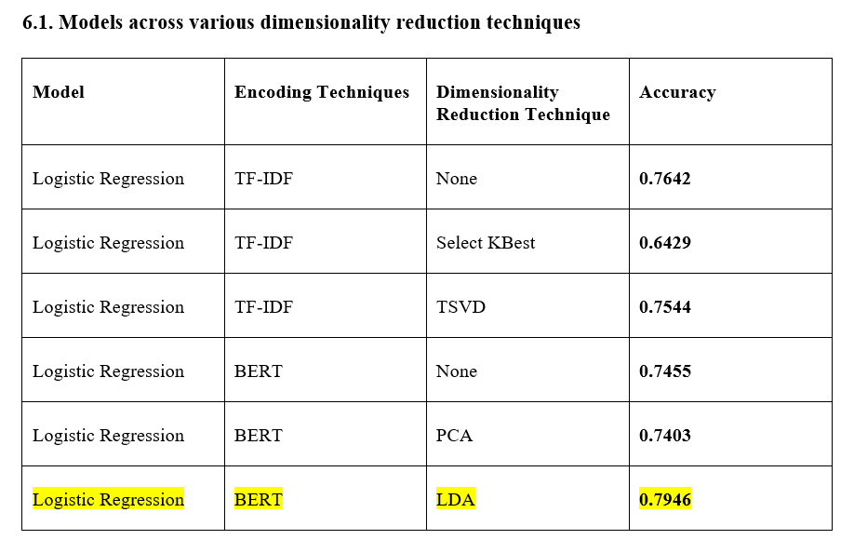
Test accuracy

Slide 44
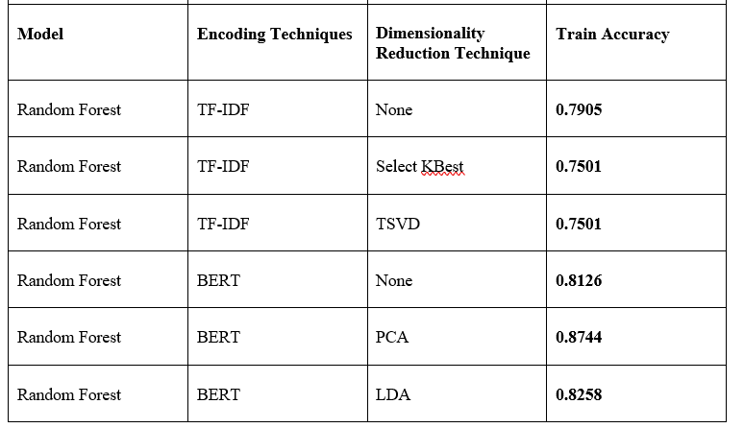
Random forest (Train accuracy)

Slide 45
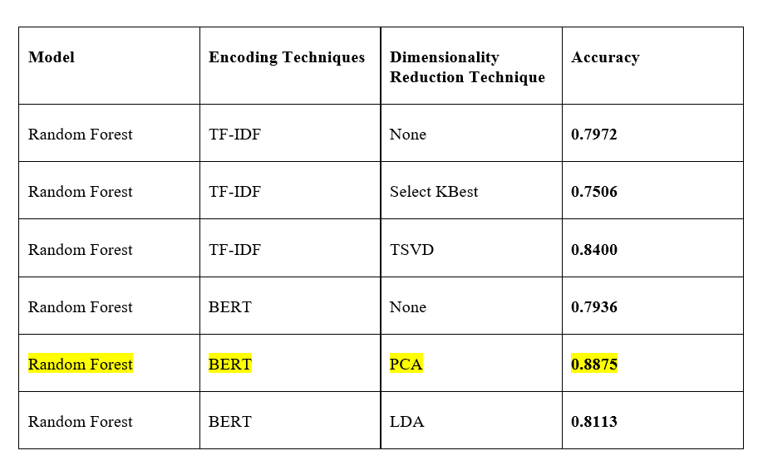
Test accuracy

Slide 46
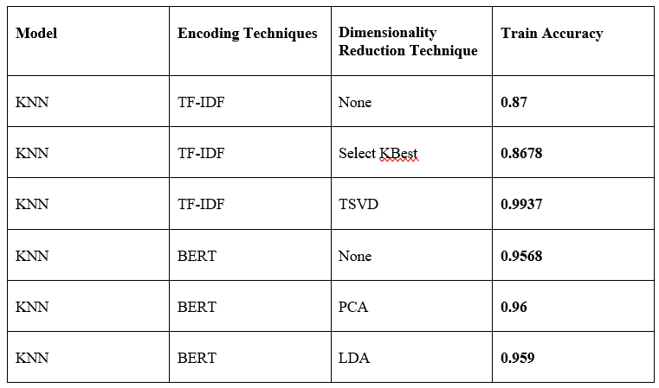
Knn (train accuracy)

Slide 47
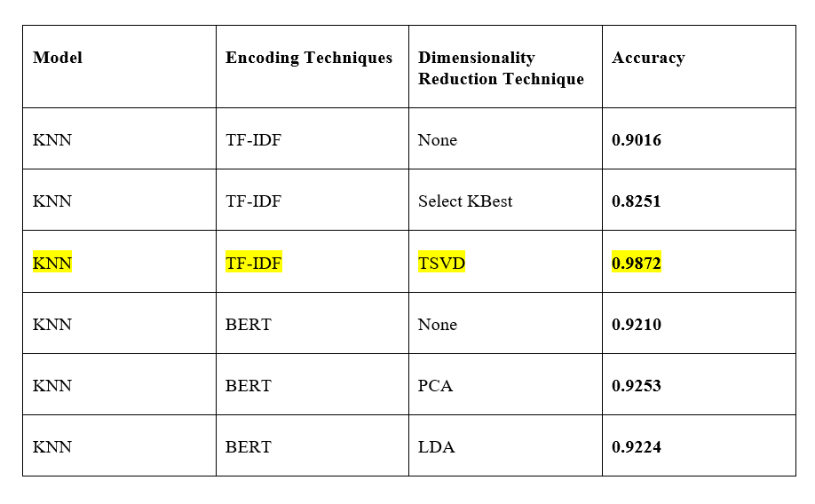
KNN

Slide 48
Comparative Analysis of Models across hyper-parameter tuning using search techniques

Slide 49
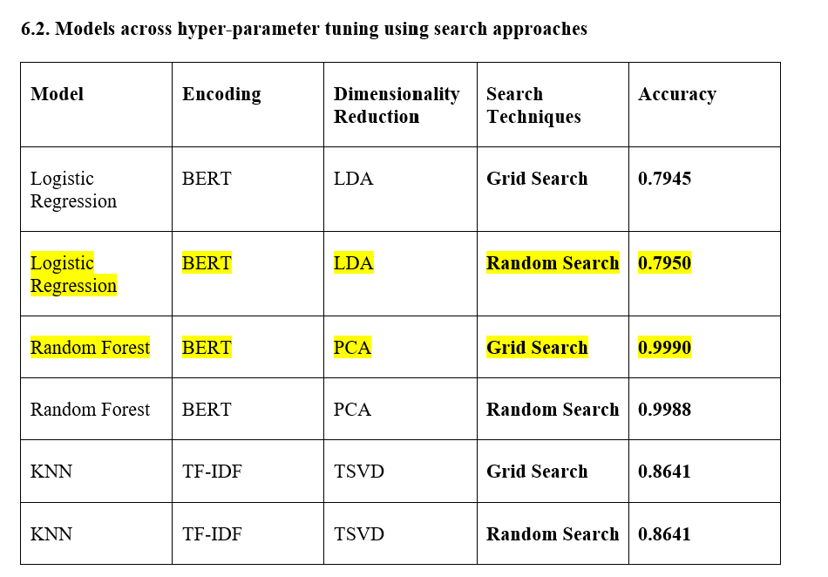
Train accuracy

Slide 50
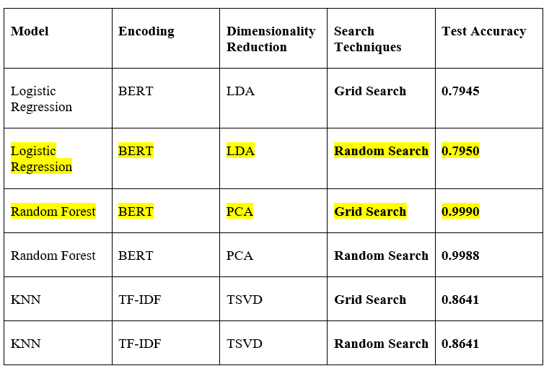
Test accuracy

Slide 51
DISCUSSION
Model accuracy varies based on encoding and dimensionality reduction techniques.
Logistic Regression (LR) performs well with TF-IDF but drops with SelectKBest due to feature loss.
BERT + LDA for LR achieves the highest accuracy (0.7946) as LDA enhances class separation.
Random Forest (RF) improves with PCA on BERT (0.8875) and TSVD on TF-IDF (0.8400) by reducing noise.
K-Nearest Neighbors (KNN) benefits most from TSVD on TF-IDF (0.9872) due to sensitivity to high-dimensional data.
Hyperparameter tuning impact is minor, with RF + BERT + PCA achieving 0.9990 accuracy using Grid Search.

Slide 52
RESULTS
For Hallucination Detection using LLMs

Slide 53
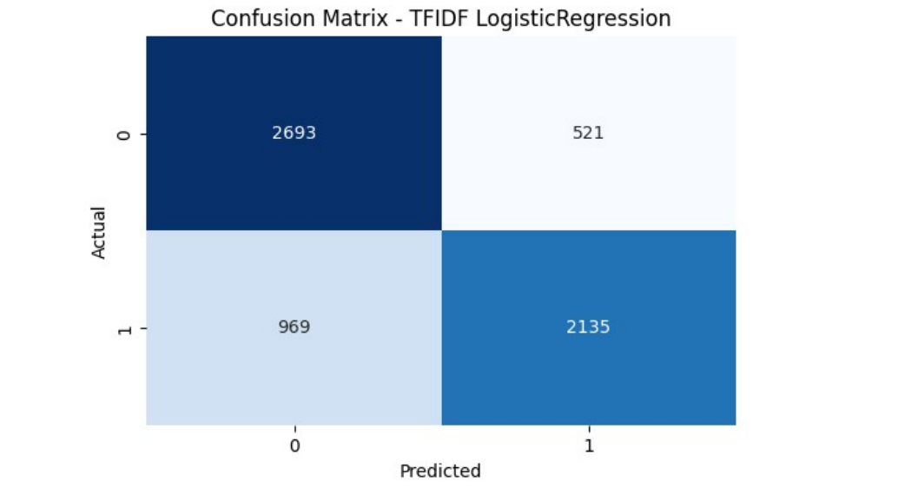
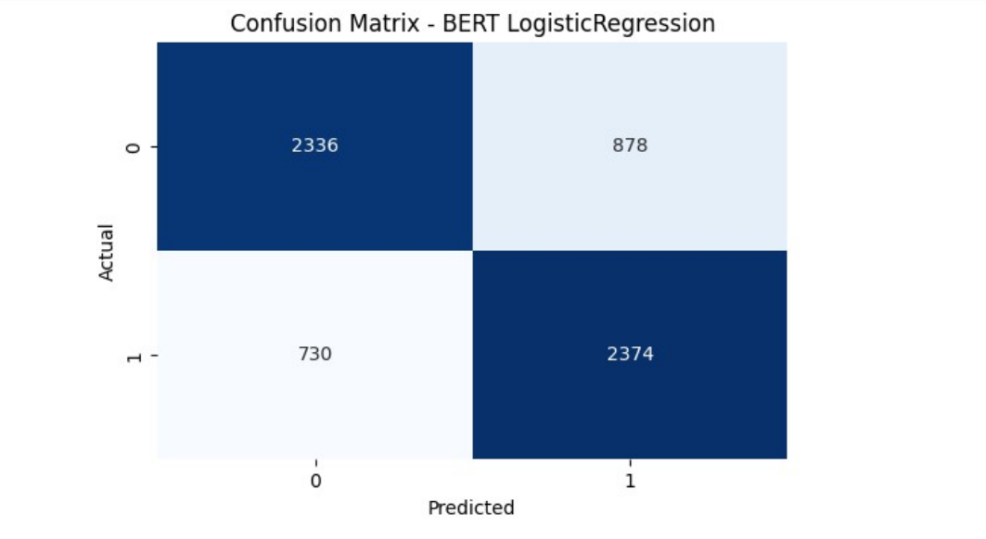
LOGISTIC REGRESSION

Slide 54
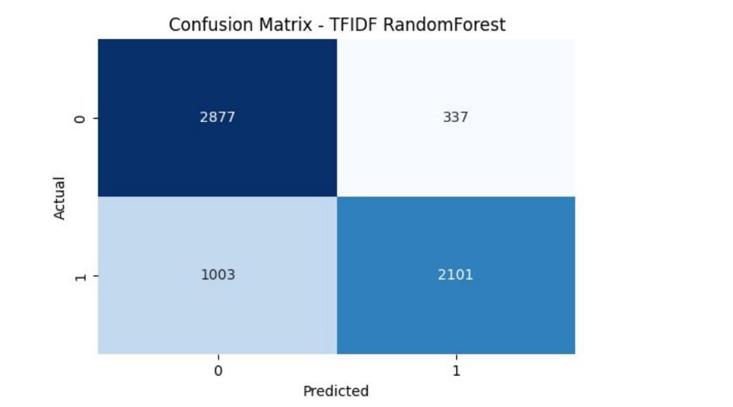
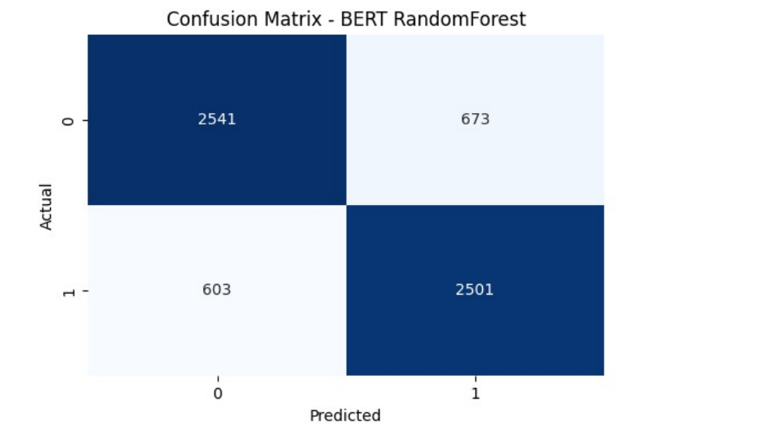
Random Forest

Slide 55
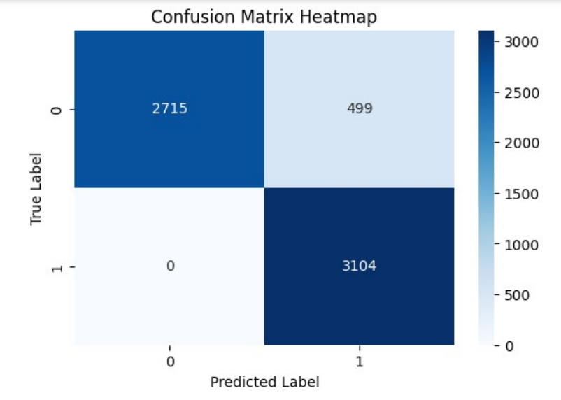
K NEAREST NEIGHBOURS

Slide 56
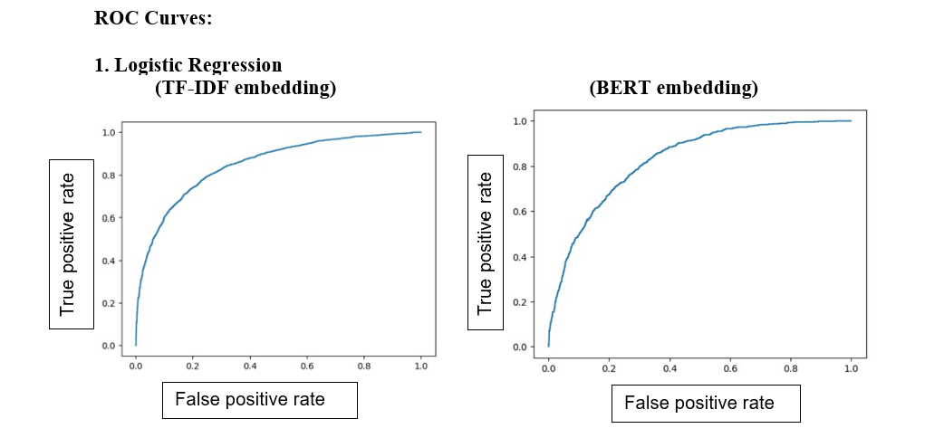
ROC CURVES

Slide 57
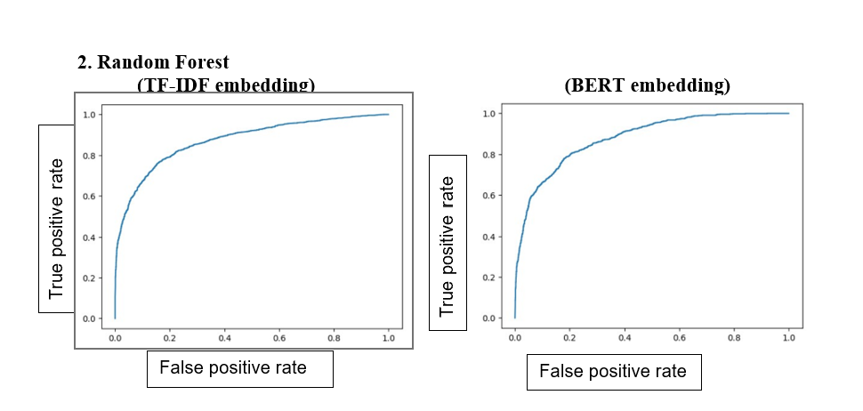
ROC CURVES

Slide 58
Comparative Analysis of Models across Dimensionality Reduction

Slide 59
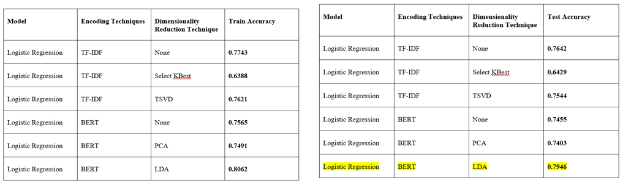
RESULTS (LOGISTIC REGRESSION)

Slide 60
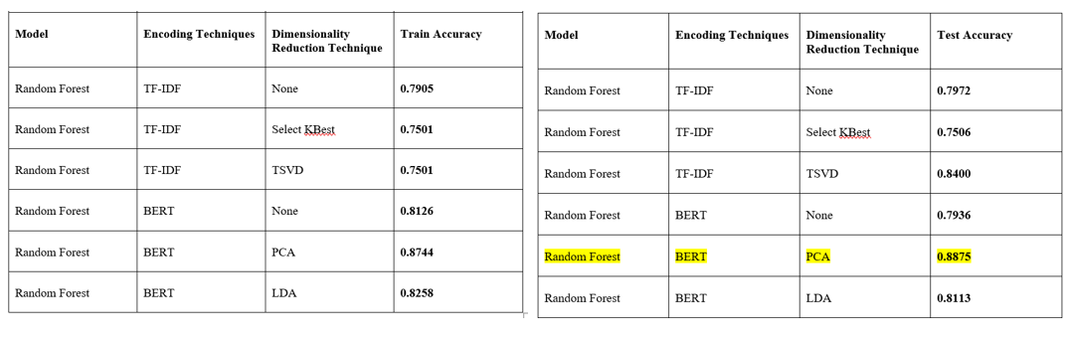
RESULTS (RANDOM FOREST)

Slide 61
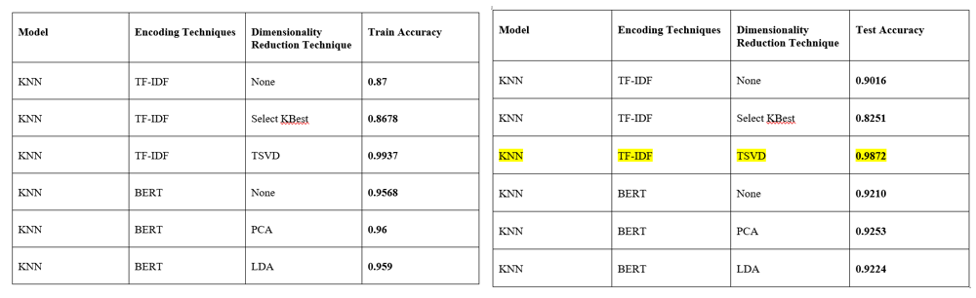
RESULTS (KNN)

Slide 62
Comparative Analysis of Models across hyper-parameter tuning using search techniques

Slide 63
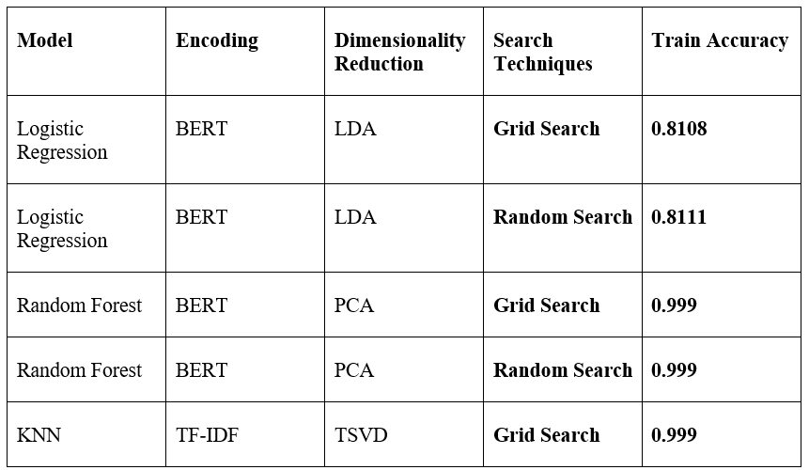
RESULTS (TRAIN)

Slide 64
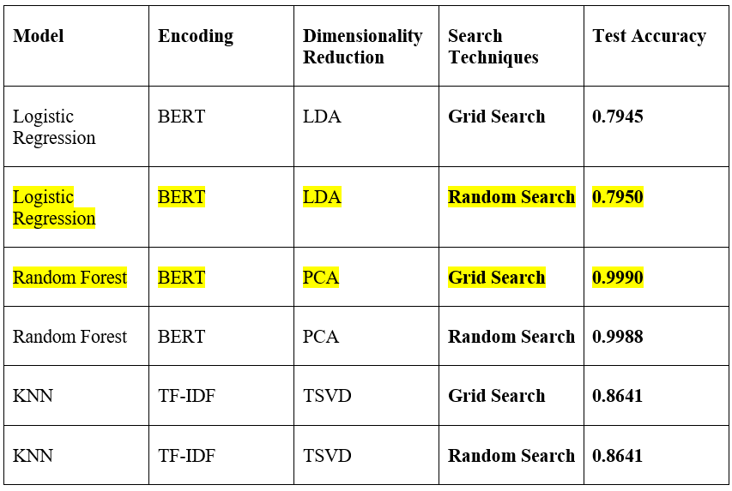
Results (test)

Slide 65
DISCUSSION
Model accuracy varies based on encoding and dimensionality reduction techniques.
Logistic Regression (LR) performs well with TF-IDF but drops with SelectKBest due to feature loss.
BERT + LDA for LR achieves the highest accuracy (0.7946) as LDA enhances class separation.
Random Forest (RF) improves with PCA on BERT (0.8875) and TSVD on TF-IDF (0.8400) by reducing noise.
K-Nearest Neighbors (KNN) benefits most from TSVD on TF-IDF (0.9872) due to sensitivity to high-dimensional data.
Hyperparameter tuning impact is minor, with RF + BERT + PCA achieving 0.9990 accuracy using Grid Search.

Slide 66
MINI PROJECT

Slide 67
ENSEMBLE MODELS feasibility
Feasibility of Ensemble Approaches
Ensemble models enhance robustness and generalization by combining multiple classifiers.
Bagging and boosting techniques help reduce variance and bias, respectively.
Models like Random Forest (bagging) and Gradient Boosting (boosting) capture complex linguistic patterns.
Effective in detecting subtle hallucinations or fabricated content from language models.
Can integrate diverse feature representations (e.g., TF-IDF and BERT embeddings).
Though computationally intensive, they significantly improve accuracy and reliability.

Slide 68
Ensemble models used
AdaBoost (Adaptive Boosting)
Sequentially combines multiple weak learners (e.g., decision stumps).
Each learner focuses on previously misclassified instances.
Effectively reduces bias in predictions.
Works well on clean and structured datasets.
Gradually improves performance by emphasizing difficult cases.
Useful in hallucination detection pipelines for improved reliability

Slide 69
Ensemble models used
Gradient Boosting Classifier
Builds an ensemble of decision trees in a stage-wise fashion.
Optimizes a differentiable loss function.
Balances bias and variance effectively.
Flexible tuning for learning rate, depth, and regularization.
Excels at modeling complex relationships in data.
Adds value to hallucination detection by improving generalization.

Slide 70
Ensemble models used
XGBoost (Extreme Gradient Boosting)
Highly efficient and scalable boosting technique.
Uses gradient descent with built-in regularization to prevent overfitting.
Delivers high accuracy on structured/tabular data.
Offers strong performance across diverse classification tasks.
Known for speed, efficiency, and accuracy.
Enhances hallucination detection through robust learning mechanisms.

Slide 71

Deploying in github
Used GitHub for version control and collaboration.
Applied essential Git commands:
git init – Initialized the local repository.
git add . – Staged all files.
git commit -m "Initial commit" – Committed changes with a message.
git remote add origin <repository_url> – Linked to GitHub.
git push -u origin main – Pushed code to the main branch.
git status, git log, git diff – Tracked changes and history.
git branch, git checkout – Handled branches for feature development.

Slide 72
Comparative Analysis of Ensemble Models acrossDimensionality Reduction

Slide 73
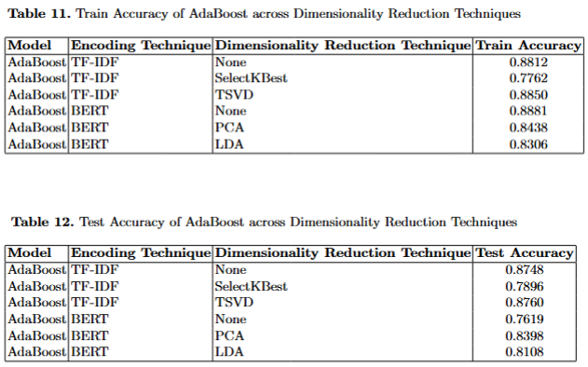

Slide 74
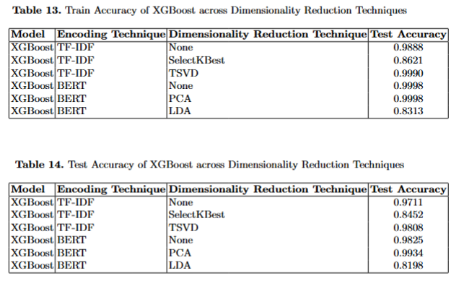

Slide 75
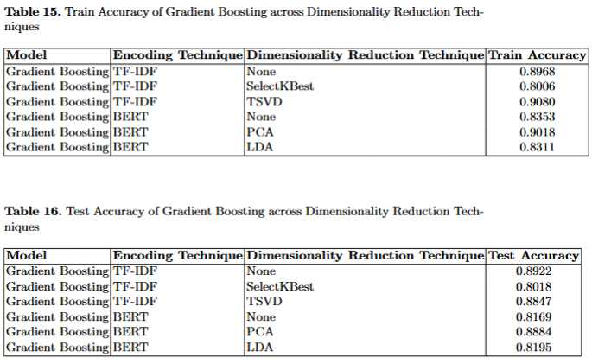

Slide 76
Comparative Analysis of Ensemble Models across hyper-parameter optimization techniques

Slide 77
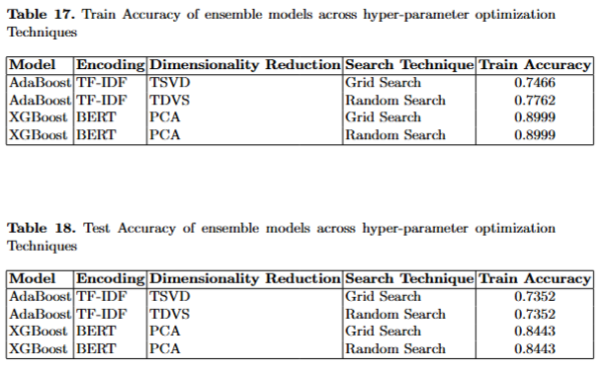

Slide 78
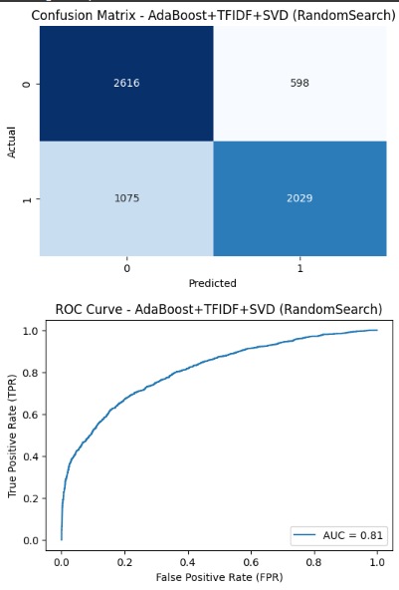
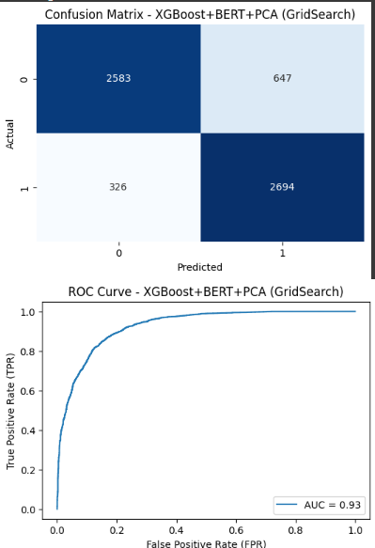
VISUALIZATION

Slide 79
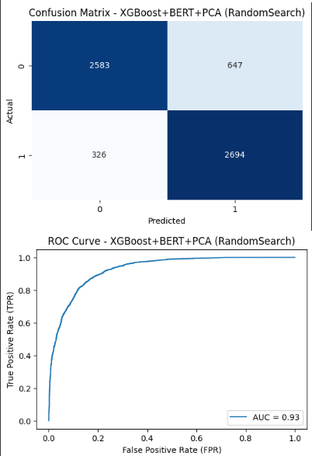
VISUALIZATION

Slide 80
Thank you

